Slide 1
Data Sources
OW

Slide 2
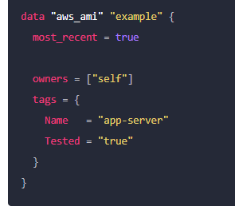
Data Sources
Data sources allow Terraform to use information defined outside of Terraform, defined by another separate Terraform configuration, or modified by functions.
A data source is accessed via a special kind of resource known as a data resource, declared using a data block:

Slide 3
..
In Terraform, you cannot save the results of a data source block directly.
Data sources are used to retrieve information dynamically during the Terraform execution, and their values are not saved in the state file or persisted between runs.
you can capture and save the output of a data source block by using an output block in your Terraform configuration.

Slide 4
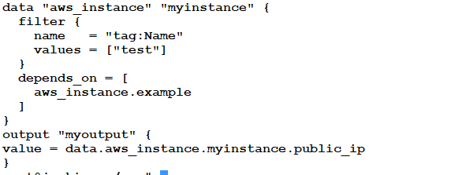
Data block

Slide 5
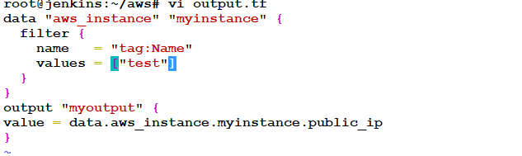
Query on non-terraform provisioned vm

Slide 6
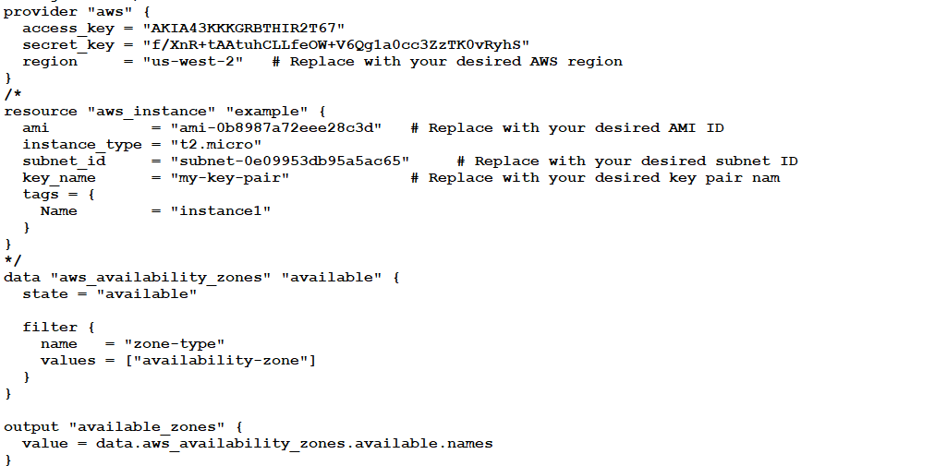
List the az available in zone

Slide 7
..
The aws_availability_zones data source retrieves information about the availability zones available in your AWS region.
The state parameter is set to "available" to filter for only the available availability zones. This ensures that only the active zones are considered.
The filter block is used to further filter the results. In this case, it filters by the "zone-type" attribute and selects availability zones.

Slide 8
Try
Create a datasource which list the ami
owners = ["amazon"]
Use filter
name = "architecture"
values = ["x86_64"]
name = "state"
values = ["available"]
name = "root-device-type"
values = ["ebs"]

